Slide 1


File Processing
Nazrin Dolkhanova Sultanli
Programming and Computer Applications – 1

Slide 2



Agenda
Open and close Files
Reading Files
Writing Files
rewind() and fseek()

Slide 3

Topic nine
File Processing

Slide 4
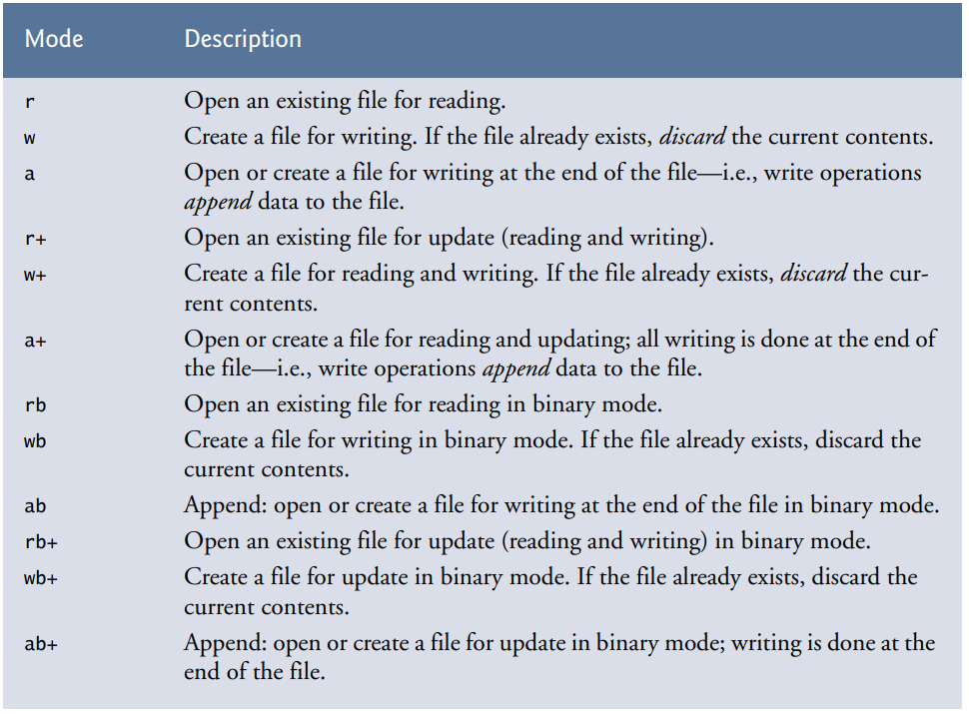
9.1 Open and close Files
When working with files, you need to declare a pointer of type file. This declaration is needed for communication between the file and the program.
FILE *fptr;
Opening a file is performed using the fopen() function defined in the stdio.h header file.
The syntax for opening a file in standard I/O is:
ptr = fopen("fileopen","mode");
Example: fopen("E:\\cprogram\\newprogram.txt","w");
The file (both text and binary) should be closed after reading/writing.
Closing a file is performed using the fclose() function.
fclose(fptr);
Here, fptr is a file pointer associated with the file to be closed.

Slide 5
9.2 Reading Files
int fputc( int c, FILE *fp );
The function fputc() writes the character value of the argument c to the output stream referenced by fp. It returns the written character written on success otherwise EOF if there is an error. You can use the following functions to write a null-terminated string to a stream −
int fputs( const char *s, FILE *fp );
The function fputs() writes the string s to the output stream referenced by fp. It returns a non-negative value on success, otherwise EOF is returned in case of any error.
int fprintf(FILE *fp, const char *format, ...)
The function fprintf() writes a string into a file as well.

Slide 6
9.3 Writing Files
int fgetc( FILE * fp );
The fgetc() function reads a character from the input file referenced by fp. The return value is the character read, or in case of any error, it returns EOF. The following function allows to read a string from a stream −
char *fgets( char *buf, int n, FILE *fp );
The functions fgets() reads up to n-1 characters from the input stream referenced by fp. It copies the read string into the buffer buf, appending a null character to terminate the string. If this function encounters a newline character '\n' or the end of the file EOF before they have read the maximum number of characters, then it returns only the characters read up to that point including the new line character.
int fscanf(FILE *fp, const char *format, ...)
The function reads strings from a file, but it stops reading after encountering the first space character.

Slide 7

9.4 rewind() and fseek()
If you have many records inside a file and need to access a record at a specific position, you need to loop through all the records before it to get the record.
This will waste a lot of memory and operation time. An easier way to get to the required data can be achieved using fseek().
As the name suggests, fseek() seeks the cursor to the given record in the file.
fseek(FILE * stream, long int offset, int whence);
The first parameter stream is the pointer to the file. The second parameter is the position of the record to be found, and the third parameter specifies the location where the offset starts.
void rewind(FILE *stream) sets the file position to the beginning of the file of the given stream.

Slide 8

References
Each Reference is indicated on the footer on each slide.
Books:
The_C_Programming_Language_(2nd_Edition_Ritchie_Kernighan)
Learn to Program with C_ Learn to Program using the Popular C Programming Language (Noel Kalicharan)
C How to Program, 8th edition, Paul Deitel and Harvey Deitel, Pearson, 2016.

Slide 9


Thank You
Nazrin Dolkhanova Sultanli
Nazrin.Sultanli.Dolkhanova@bhos.edu.az
Baku Higher Oil School

